Slide 1
The Flexible Job Shop Scheduling Algorithm
Notes:
The flexible job shop scheduling algorithm is an extension of the job shop scheduling problem: an NP-hard algorithm that attempts to assign jobs to resources in the most optimized fashion.

Slide 2


Jobs {$J_{1}, J_{2}, …, J_{n}\}$
Machines {$M_{1}, M_{2}, …, M_{m}\}$
Job 1
Every job is done by
every machine exactly once
Machine 1
Job 2
$$M_{1}\underset{→}{\text{yields}}$$
𝑀_1 →┴"yields"
$$J_{1}$$
𝐽_1
$$J_{3}$$
𝐽_3
$$J_{2}$$
𝐽_2
Machine 2
.
.
.
.
.
.
Job n
Machine m
Notes:
The traditional algorithm takes n jobs and m machines, and finds the most optimal way to run all the jobs through any individual machine for every machine. For example, the algorithm may find that the most optimal way to run three jobs through machine 1 is to first run job 1, then job 3, then job 2. However, (next slide)

Slide 3
Jobs {$J_{1}, J_{2}, …, J_{n}\}$
Machines {$M_{1}, M_{2}, …, M_{m}\}$
Job 1
Every job is done by
every machine exactly once
Machine 1
Job 2
$$M_{2}\underset{→}{\text{yields}}$$
𝑀_2 →┴"yields"
$$J_{2}$$
𝐽_2
$$J_{1}$$
𝐽_1
$$J_{3}$$
𝐽_3
Machine 2
.
.
.
.
.
.
Job n
Machine m
Notes:
Machine 2 would run the same jobs most optimally by first running job 2, then job 1, then job 3. But this type of problem is not very representative of a real-world situation. Any standard shop such as a manufacturing plant or a kitchen will have machines that cannot do some of the jobs. Furthermore one would want to run multiple jobs or tasks on multiple machines in parallel.

Slide 4
Making it flexible
Task 1
Task 2
Task n
. . . . .
Machine 1
Machine 2
Machine m
. . . . .
Notes:
The flexible job shop scheduling algorithm takes several jobs that can be completed by one or more machines. Timing and sequencing must be kept in mind as certain tasks may be dependent on others being completed. We must determine what the most optimal way to choose a task for a machine and sequence is such that the cost of running the entire process is minimized.

Slide 5
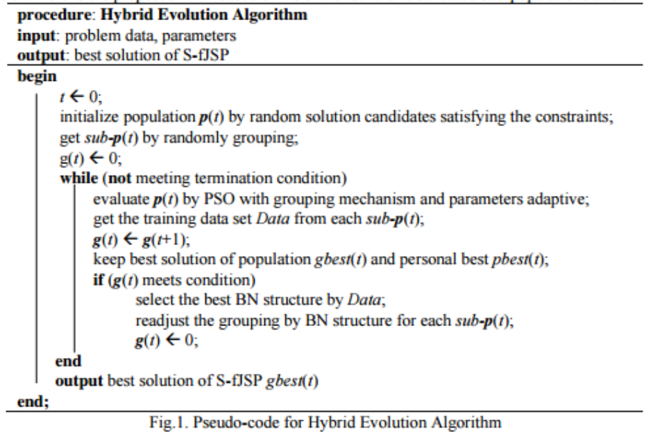
Notes:
We go into two extensions relevant to the algorithm. First, this algorithm uses evolutionary approximation methods to approximate the answer. Rather than explain how Bayesian and Evolutionary optimization works, there will be a very fast and condensed example of how the algorithm would run the task of optimizing making a Thanksgiving meal. Secondly, a critical flaw was found in the published paper about the flexible job shop scheduling algorithm. We will show that the goal of optimization through approximation was not achieved.

Slide 6
Our Example
Machines
Turkey (tasks: cook, wash)
Mashed Potatoes (tasks: boil, mash)
Pie (tasks: stir, mix, cook, etc)
Persons: Can chop, stir, mix, prep, add, etc
Oven: Can roast, bake, broil, boil and simmer in parallel
Stove: Can steam, boil, and roast
Jobs
Notes:
In this example, we will be examining how the flexible job-shop scheduling algorithm attempts to optimize the preparation of a Thanksgiving meal. The machines available include three people, an oven, and a stove. Each machine can complete a defined set of tasks. The jobs to be completed include preparing a turkey, mashed potatoes, and a pie, where each job requires a sequence of tasks in which the order is defined. Each task requires a specific amount of time to complete, and in this example, all times will be composed of one hour increments.

Slide 7
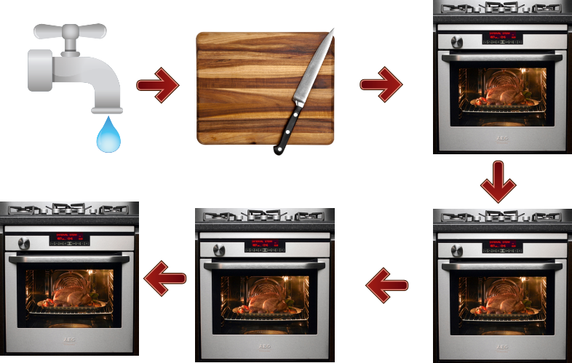
Ideal Turkey Sequence
Notes:
In order to complete the job of turkey preparation, the turkey must be washed, prepped, and cooked for four hours.

Slide 8
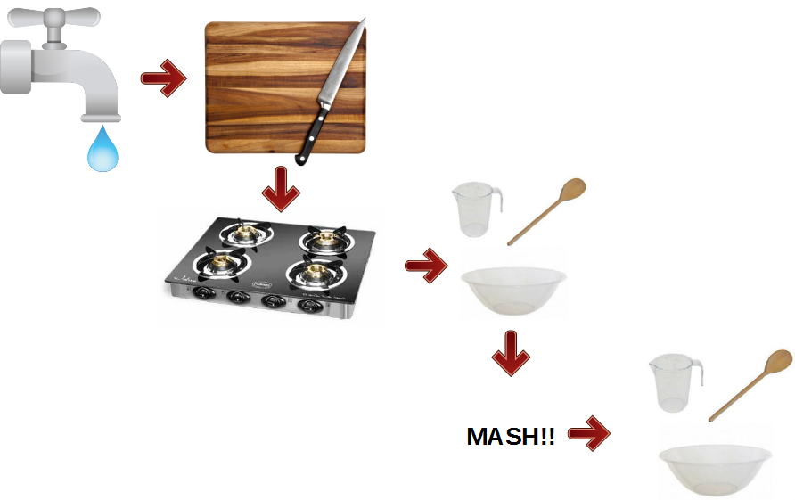
Ideal Mashed Potatoes Sequence
Notes:
Mashed potatoes must be washed, chopped, boiled, stirred, mashed, and stirred once more.

Slide 9
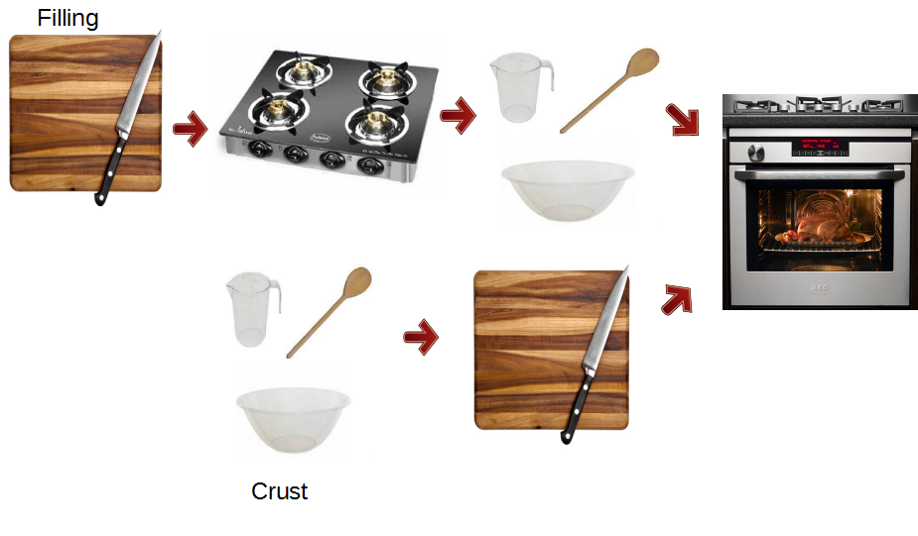
Ideal Pie Sequence
Notes:
To complete a pie, the filling must be prepped, cooked, and mixed. The crust must be mixed and prepped. Once both the filling and crust are completed, the pie is then cooked for one hour.

Slide 10
The Algorithm: Step 0
Roll out pie dough
Chop potatoes
Cook turkey
Wash turkey
Wash potatoes
Cook pie
Prep turkey
Add filling to dough
Stir potatoes
Mash potatoes
Boil potatoes
Mix pie filling
Stir pie filling
Mix pie dough
Cook pie filling

Slide 11
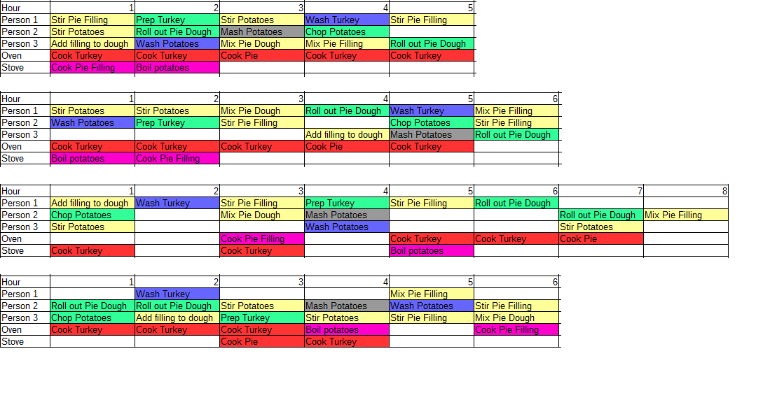
The Algorithm: Step 1 Generate Random Orderings
Add in tables

Slide 12
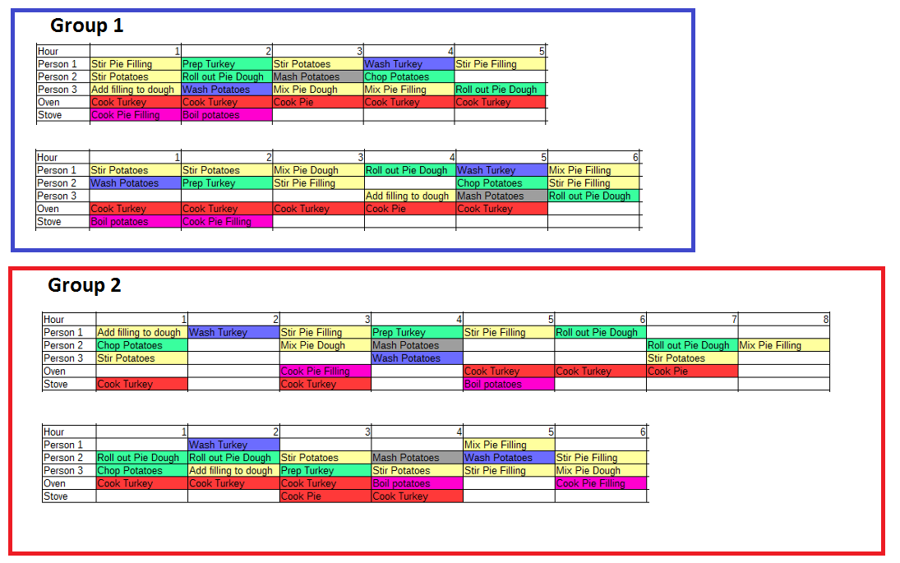
The Algorithm: Step 2 Randomly Group Orderings
Add in tables

Slide 13
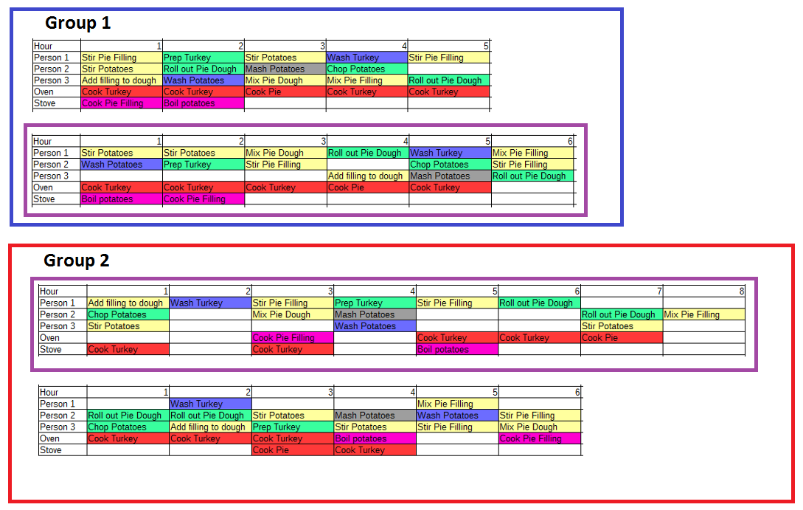
The Algorithm: Step 3 Select best individuals using fitness function
Add in tables

Slide 14

The Algorithm: Step 4 “Push” all individuals in the right direction
Add in tables

Slide 15
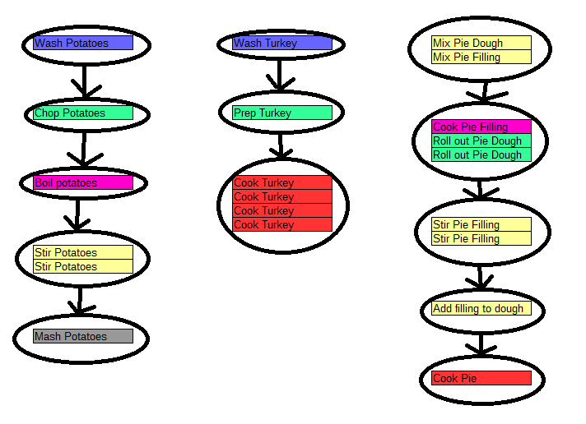
The Algorithm: Step 5 Select best Bayesian network
Add in tables

Slide 16
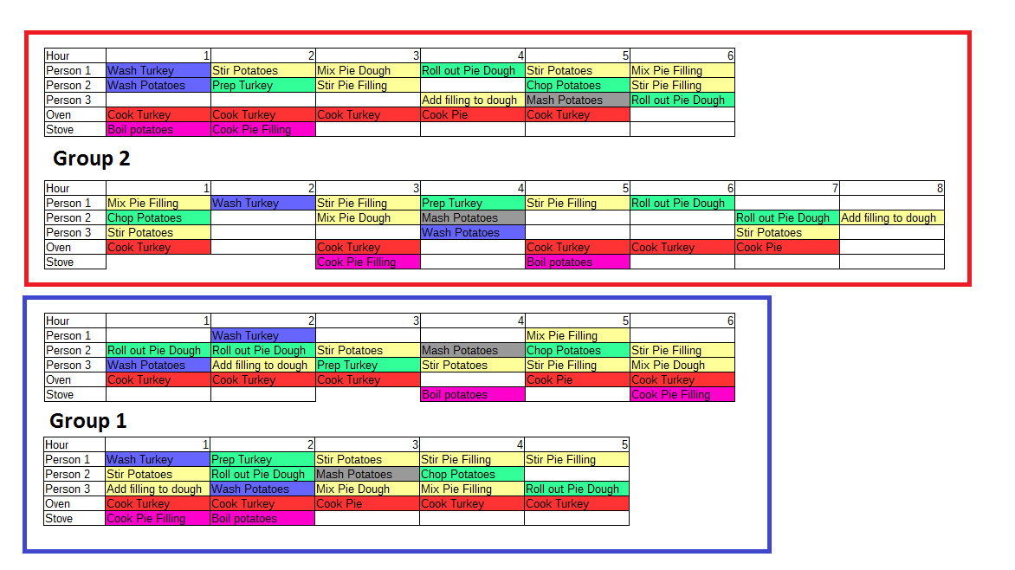
The Algorithm: Step 6 Regroup orderings using Bayesian Network
Add in tables

Slide 17
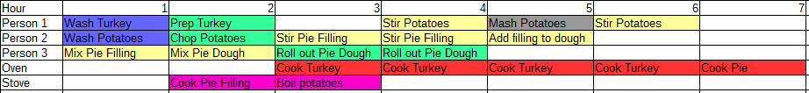
Loop until a good solution is reached
Notes:
Finally, a solution is reached that fits the criteria set forth for a good solution. Keep in mind this may not be the true optimal solution, but it is determined to be an acceptable approximation.

Slide 18
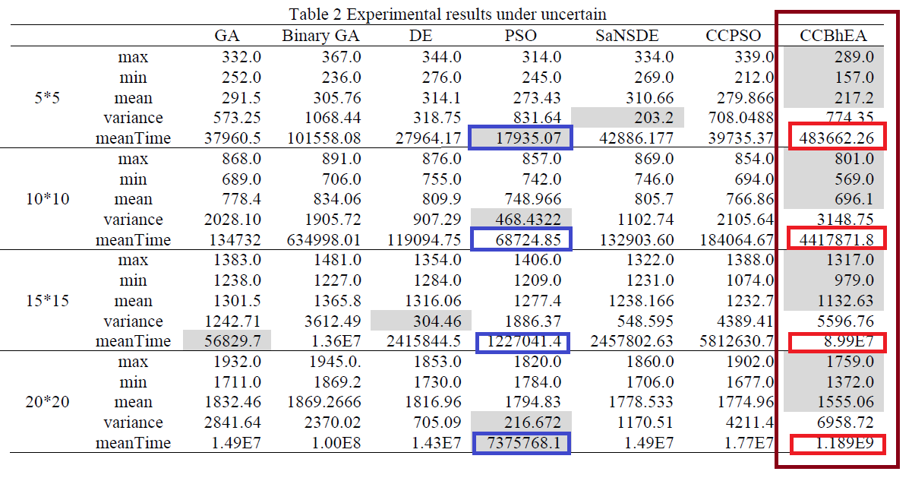
Algorithm Analysis and Critique
Notes:
These are the experimental results of the hybrid evolutionary algorithm provided in the publication. The column to the far right displays the results achieved with the previously detailed approach, while the other columns describe the results of competing algorithms. The experiment was run on data sets involving varying population and group sizes. The authors claim their approach to be superior due to the decreased number of generations required to approximate an optimal solution across all problem sizes, as marked by the grey boxes. However, the average run time in each case is far larger than competing algorithms. In fact, when run on the largest data set, the proposed hybrid evolutionary algorithm has a larger run time that particle swarm optimization by a factor of over 100.

Slide 19
Mean Time Per Generation
 | Mean Time | Mean Generations | Mean Time/Generation
GA | 37960.5 | 291.5 | 130.2
Binary GA | 101558.1 | 305.8 | 332.1
DE | 27964.2 | 314.1 | 89.0
PSO | 17935.1 | 273.4 | 65.6
SaNSDE | 42886.2 | 310.7 | 138.0
CCPSO | 39735.4 | 279.9 | 142.2
Hybrid Evolutionary Algorithm | 483662.3 | 217.2 | 2226.8
Notes:
This table demonstrates the mean time per generation of each of the algorithms when run on the smallest data set from the study. While the hybrid evolutionary algorithm requires fewer generations, the mean time per generation is about 30 times greater than the particle swarm approach. As the set of data under test grows, this disparity increases even further.

Slide 20
Analysis And Critique
Learning Bayesian Networks is an NP-Complete problem
Notes:
This long generation time is probably due to the fact that the algorithm is dependent on learning a Bayesian Network. Learning a Bayesian has been shown to be NP-Complete.

Slide 21
Necessary Fixes To Their Approach
Prove their algorithm was faster than a specific solution
Prove their algorithm produced a better approximation than other evolutionary approaches
Prove their design had better concurrency and potential for parallelization
Prove an approximation lower-bound through Bayesian Network Selection reduction
Notes:
In order for the authors of the proposed hybrid evolutionary algorithm to validate their approach, they either need to prove that it completes faster than a competing solution, prove that the approximated solution is more accurate than other approaches, prove that there is a greater potential for concurrency and parallelization, or prove an approximation lower-bound through Bayesian Network Selection reduction.

